Slide 1
BJT as amplifier
Reference: Sedra & Smith
Microelectronic Circuits

Slide 2
Using BJT as amplifier
We need to connect BJT to DC voltage sources of appropriate value to bias the BJT in active mode (Saturation & Cutoff mode are used for switching applications)
Apply a small ac signal as input (Why ac signal should be small?)
An amplified version of input ac will appear in output (Are we breaking the law of energy conservation?)

Slide 3
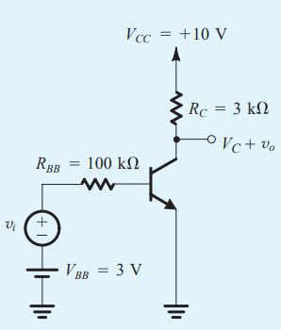
Example of a BJT circuit with DC & AC voltage sources
How do we analyze the circuit?
VBB and VCC are DC voltage sources
vi is an AC voltage source

Slide 4
Example (Contd.)
Use superposition
Keep only the DC voltage sources and solve the circuit. The results are called DC bias point. For amplifier operation, DC bias point should be in active mode
Keep only the AC voltage sources and solve the circuit.
Total output will be superposition of DC and AC output

Slide 5
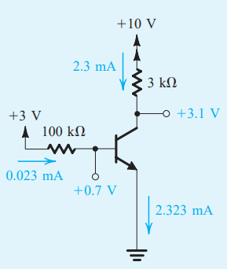
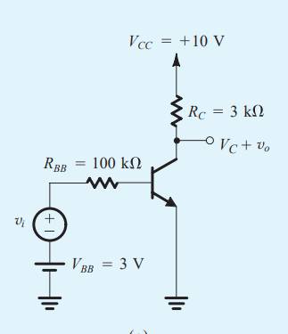
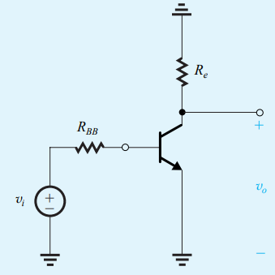
Example (Contd.)
For DC sources
For AC sources

Slide 6
Example (Contd.)
We have already learnt how to solve BJT circuits for DC sources
But how to solve the circuit for small AC source?
We do not follow the procedure to solve BJT circuits for DC (why?), rather we replace BJT with equivalent models. These models are known as small signal models.

Slide 7
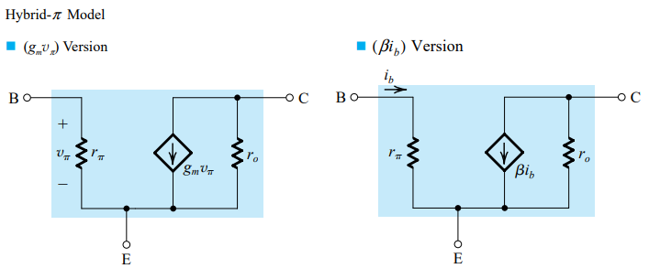
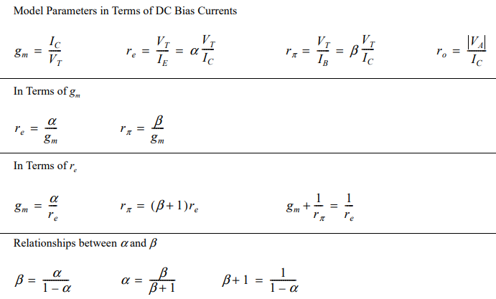
Small signal Models : Hybrid pi model

Slide 8
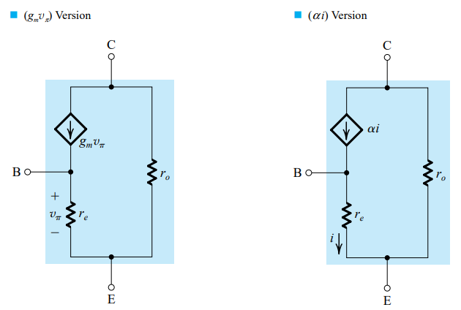
Small signal Models : T model
ro is sometimes assumed infinity to simplify calculation
T model is usually more helpful than pi model, when there is resistance connected
with emitter

Slide 9
How did we get these models?
Refer to following section of Sedra Smith’s book in BJT chapter

Slide 10
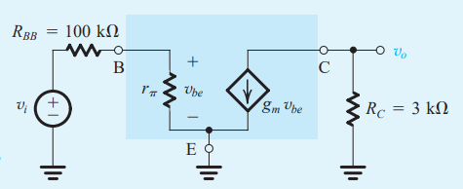
Back to example(contd.)
For AC source
Replacing the BJT with equivalent pi model
ro is assumed
Infinity here,
Since early voltage
Is not given in the
question

Slide 11
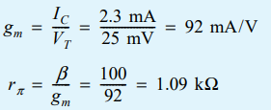
Example (Contd.)
Let’s suppose we need to find the voltage gain, vo/vi of the amplifier

Slide 12
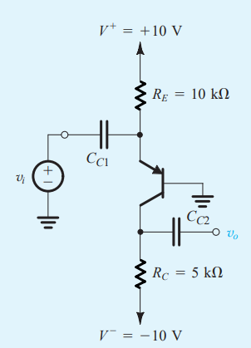
Another example
Draw the DC circuit and AC equivalent circuit

Slide 13
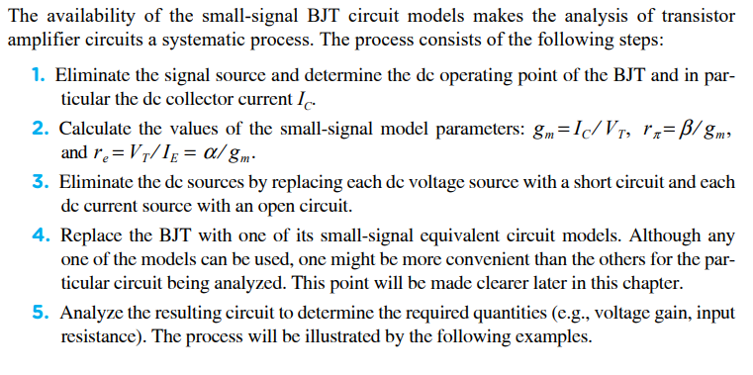
Procedure to solve BJT circuits with DC & AC sources

Slide 14
Characterizing Amplifiers
How do we compare two amplifier’s performances?
Input Resistance
Output Resistance
Voltage Gain
Current Gain

Slide 15
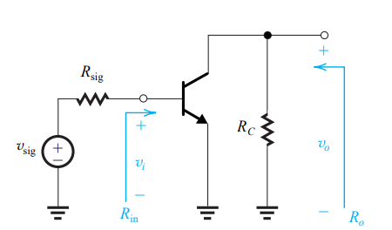
3 basic config : CE amplifier

Slide 16
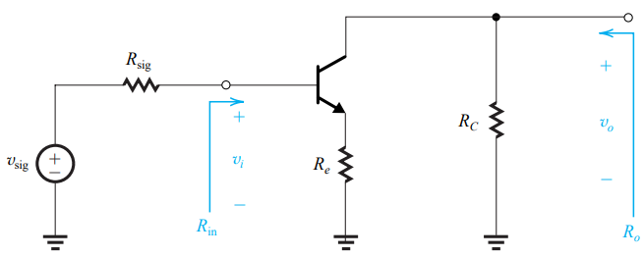
CE Amplifier with emitter resistance

Slide 17
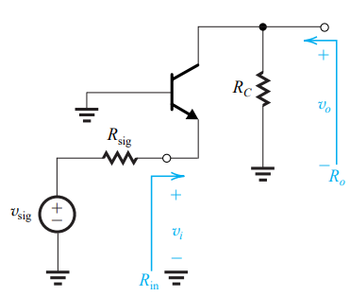
CB Amplifier

Slide 18
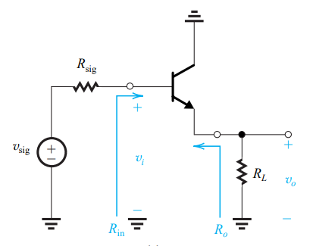
CC Amplifier

